Slide 1



A CENTER FOR INTER-DISCIPLINARY RESEARCH
2018-19
AUTOMATED REGISTRATION DESK
FOR EVENTS
SUPERVISED BY
Y.CHETHAN REDDY
GOKARAJU RANGARAJU
INSTITUTE OF ENGINEERING AND TECHNOLOGY
AUTONOMOUS

Slide 2

Advanced Academic Center
( A Center For Inter-Discilinary Research)
This is to certify that the project titled
"AUTOMATED REGISTRATION DESK FOR EVENTS”
is a bonafide work carried out by the following students
in partial fulfilment of the requirements for Advanced Academic Center intern, submitted to the chair, AAC during the academic year 2019-2020
NAME | ROLL NO. | BRANCH
VENKATA KARTHIKA K | 18241A04U0 | ECE
P PHANI SRIKAR REDDY | 18241A04S0 | ECE
CHOWDARY SUNITHA | 18241A04P7 | ECE

Slide 3
NAME | ROLL N0 | BRANCH
K. Kavitha Kiran | 18241A1225 | IT
D.Bala Yashwanth | 18241A1276 | IT
Gayatri Devi | 18241A1218 | IT
Akunuri Roshini | 18241A1203 | IT
This work was not submitted or published earlier for any study
Dr/Ms./Mr.
Dr.B.R.K.Reddy
Program Coordinator
Dr.Ramamurthy Suri
Associate Dean,AAC
Project Supervisor

Slide 4


ACKNOWLEDGEMENTS
We express our deep sense of gratitude to our respected Director , Gokaraju Rangaraju Institute of Engineering and Technology for the valuable guidance and for permitting us to carry out this project.
With immense pleasure, we record our deep sense of gratitude to our respected principal, for permitting us to carry out this project.
We are thankful to Associate Dean ,Advance Academic Centre for providing us appropriate ecosystem required for the project to complete.
We are thankful to our project supervisor who spared valuable time for us and influence novel ideas to guide us. I am indebted to all the above without whom I would not have concluded the project.

Slide 5
TABLE OF CONTENTS Authorisation i
Acknowledgement ii
Executive summary/Abstract/synopsis iii
1. Introduction 7
1.1 Purpose, scope and limitations 7
1.2 Scope of study 8
2. System Analysis 9
2.1 Present System 9
2.2 Limitations of Present System 9
2.3 User Requirements 10
2.4 Technical Feasibility 10
3. Registration Process 11
4. Attachments 14 5.Code commands 16 6.Hardware prototype 19 7. Reference 20 8. Glossary 21

Slide 6
ABSTRACT
The project entitled “ Automated Registration Desk for Events “ is made to suit the needs of the registration process .The purpose of this application is to allow the registration of students in particular course.It is intended to have complete specifications what registration process has.
The software is developed using Python and Tkinter library inbuilt in it.Python is now widely used for various projects because it is easy to understand and use.Being a database project ,we used SQLite ,it concentrates on the use of database objects.This application is loaded to raspberry pi which acts as CPU to our monitor. It handles registrations for various courses.

Slide 7
1.INTRODUCTION
1.1 Purpose, scope and limitations
This project aims at enrolling the students into various courses in college or university.It contains the registration form for entering the student’s data for enrolling .This data is stored for later times.
The section wants to computerize the existing system in order to increase the speed of processing as well as for simplifying the activities,without loosing accuracy.
The system is expected to computerize activities of the college in enrollments. This application is for registering in particular course.It is planned to implement retrieval of data in the future.

Slide 8
1.2 Scope of Study
The project is aimed at implementation of basic concepts of python-Tkinter , SQLite database and using of Raspberry pi .
This will help the college in generating its daily reports by providing necessary information. The system is expected to computerize activities of the college in enrollments.

Slide 9
2.SYSTEM ANALYSIS
2.1 PRESENT SYSTEM
The present system is manual.The flow of activities is as follows:
The registration details are written in paper and are kept in one file.
2.2 LIMITATIONS OF THE PRESENT SYSTEM
· The present system is too slow,since entering details in files and registers and generating reports from them is to be done manually.
· If we need to change any details ,it is quite difficult to search for specified student.
· Human induced errors are more like to occur in this system.

Slide 10
2.3 USER REQUIREMENTS:
The section wants to computerize the existing system in order to increase the speed of processing as well as for simplifying the activities,without loosing accuracy.
2.4 TECHNICAL FEASIBILITY:
The software can to be developed using the existing technology.Python ,SQlite database can be downloaded in free.Raspberry pi is available in reasonable cost.

Slide 11
3.REGISTRATION PROCESS
We have built a GUI application where candidates register himself/herself through the self registration desk.
Tkinter is a standard GUI library for python.Python combined with Tkinter provides a fast and easy way to create GUI applications. We typed code in python using Tkinter.
The graphical user interface (GUI) is a form of user interface that allows users to interact with electronic devices through graphical icons and visual indicators such as secondary notation, instead of text-based user interfaces, typed command labels or text navigation.
Using this application provided basic entry columns for the candidate to enter their details. The details are as follows:
· Name
Gender

Slide 12
Roll no
Branch
Section
Phone number
Parents phone number
Email-Id
Inter marks
10th GPA
EAMCET Rank
JEE-mains Rank
Intermediate college
Permanent address
Date and Time of form filling
Should agree to the Terms and Conditions

Slide 13
After this we linked our application to SQLite database to store the entered details of the candidate.
SQLite is an in-process library that implements a small, fast,self- contained,high reability, full featured SQL database engine.It is free for both private and commercial purposes.
This total code is uploaded to Raspberry pi and connected to monitor.
A Raspberry Pi is a small low powered computer. It has an ARM processor that can run a Linux desktop operating system.
We used espeak in our code ,which is a command line tool for Linux that converts text to speeh. This is a compact speech synthesizer that provides support to English and many other languages.

Slide 14
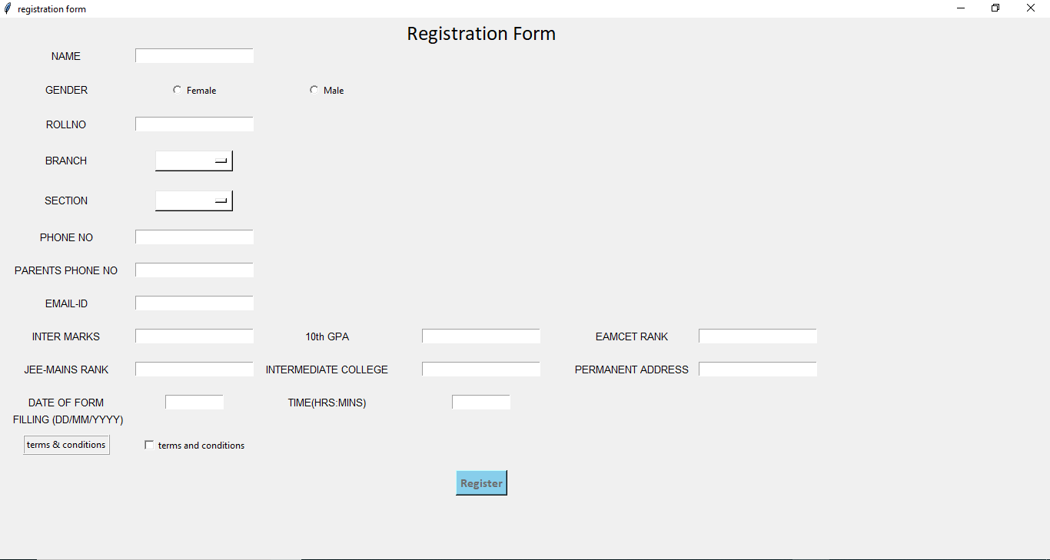
4.ATTACHMENTS

Slide 15
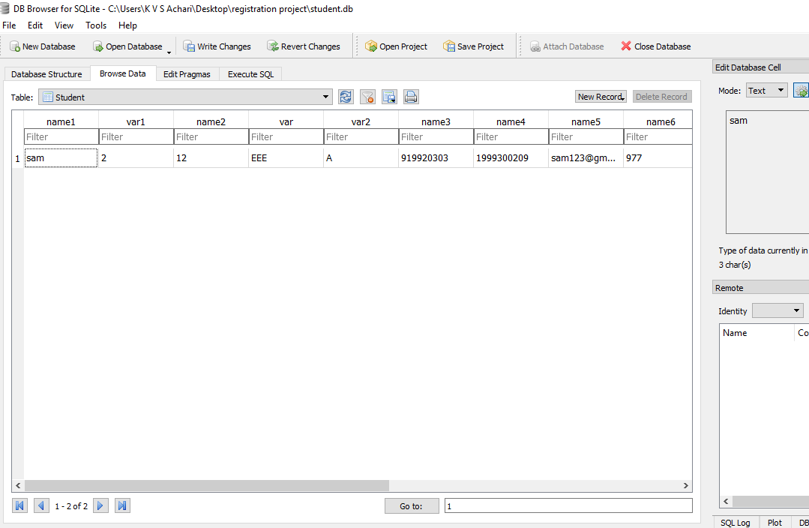

Slide 16
5.CODE COMMANDS
Button:To add a button in your application, this widget is used.
The general syntax is:
w=Button(master, option=value)
master is the parameter used to represent the parent window.
CheckButton: To select any number of options by displaying a number of options to a user as toggle buttons.
The general syntax is:
w = CheckButton(master, option=value)
master is the parameter used to represent the parent window.
Entry: It is used to input the single line text entry from the user. For multi-line text input, Text widget is used.
The general syntax is:
w=Entry(master, option=value)
master is the parameter used to represent the parent window.

Slide 17
Label: It refers to the display box where you can put any text or image which can be updated any time as per the code.
The general syntax is:
w=Label(master, option=value)
master is the parameter used to represent the parent window.
Listbox: It offers a list to the user from which the user can accept any number of options.
The general syntax is:
w = Listbox(master, option=value)
master is the parameter used to represent the parent window.
MenuButton: It is a part of top-down menu which stays on the window all the time. Every menubutton has its own functionality. The general syntax is:
w = MenuButton(master, option=value)
master is the parameter used to represent the parent window.
RadioButton: It is used to offer multi-choice option to the user. It offers several options to the user and the user has to choose one option.
The general syntax is:
w = RadioButton(master, option=value)
Text: To edit a multi-line text and format the way it has to be displayed.
The general syntax is:
w=Text(master, option=value)

Slide 18
Frame: It acts as a container to hold the widgets. It is used for grouping and organizing the widgets.
The general syntax is:
w = Frame(master, option=value)
master is the parameter used to represent the parent window.
eSpeak: To make the Raspberry Pi speak and read some text aloud, we need a software interface to convert text to speech on the speakers. For this we need a Text To Speech engine. The TTS engine which we used in this is eSpeak. The voice may be a little robotic, however it runs offline which is an added plus.
syntax:
os.system(‘espeak “{}” ‘.format(string))

Slide 19
6.HARDWARE PROTOTYPE
We have designed a hardware which automatically deposits money.
Components used
- DC motors and speed controller
- Cardboard
- Plastic gears
- Bicycle spoke
- Pens
- Battery and battery connector
wire
- Rubber band
- Ice-cream stick
We have connected DC motor to pens which are on each other .When the DC motor is given with high input the pens start rolling and takes money into it. The inputs for this motors are given from Raspberry pi. All this circuit is constructed inside a cardboard box.
Further we will add money checking process into this hardware.

Slide 20
7.REFERENCE
Senior student guide: Y Chethan Reddy
Links:
https://www.youtube.com/watch?v=VMP1oQOxfM0&feature=youtu.be
https://www.youtube.com/watch?v=Md__lI9H7g8&feature=youtu.be
https://www.youtube.com/watch?v=Xt6SqWuMSA8&feature=youtu.be
https://iotbytes.wordpress.com/sqlite-db-on-raspberry-pi/

Slide 21
8.GLOSSARY
Tkinter:Tkinter is a standard GUI library for python.Python combined with Tkinter provides a fast and easy way to create GUI applications. We typed code in python using Tkinter.
GUI(Graphical User Interface):The graphical user interface (GUI) is a form of user interface that allows users to interact with electronic devices through graphical icons and visual indicators such as secondary notation, instead of text-based user interfaces, typed command labels or text navigation.
SQLite Database:SQLite is an in-process library that implements a small, fast,self- contained,high reability, full featured SQL database engine.It is free for both private and commercial purposes.

Slide 22
Raspberry Pi:The Raspberry Pi is a low cost, credit-card sized computer that plugs into a computer monitor or TV, and uses a standard keyboard and mouse. It is a capable little device that enables people of all ages to explore computing, and to learn how to program in languages like Scratch and Python.
eSpeak:Text To Speech Tool For Linux. eSpeak: Text To Speech Tool For Linux. eSpeak is a command line tool for Linux that converts text to speech. This is a compact speech synthesizer that provides support to English and many other languages.

